Slide 1
Implement resiliency in business logic layers (circuit breaker pattern)
MT

Slide 2
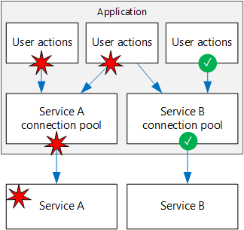
What are we trying to do here?
Build a system component which will try to execute a method call in timely fashion. If the underlying layers takes more time then configured threshold, it should return back to the user application. No asynchronous patterns allowed.

Slide 3
What is resiliency?
Resiliency is the ability of a system to gracefully handle and recover from failures, both inadvertent and malicious.
The nature of cloud hosting, where applications are often multi-tenant, use shared platform services, compete for resources and bandwidth, communicate over the Internet, and run on commodity hardware means there is an increased likelihood that both transient and more permanent faults will arise. The connected nature of the internet and the rise in sophistication and volume of attacks increase the likelihood of a security disruption.
So how to make a call from a simple ASP.NET(or any client code) method to business layer and fail it after certain time if we do not get response from underlying layers (DAL, API, NETWORKS etc)?

Slide 4
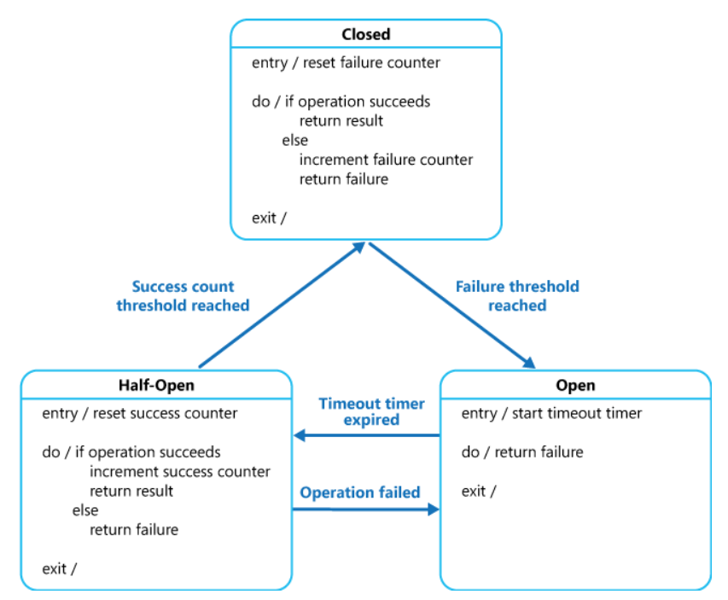
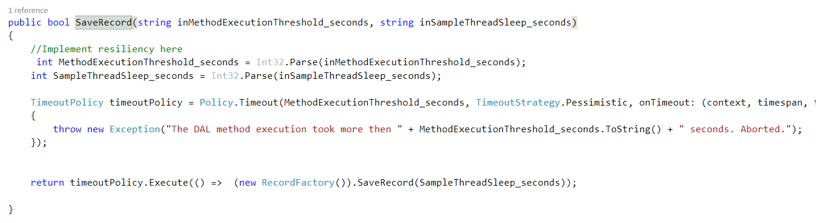
Circuit breaker pattern to help
How much should the app wait?
Sample thread sleep

Slide 5
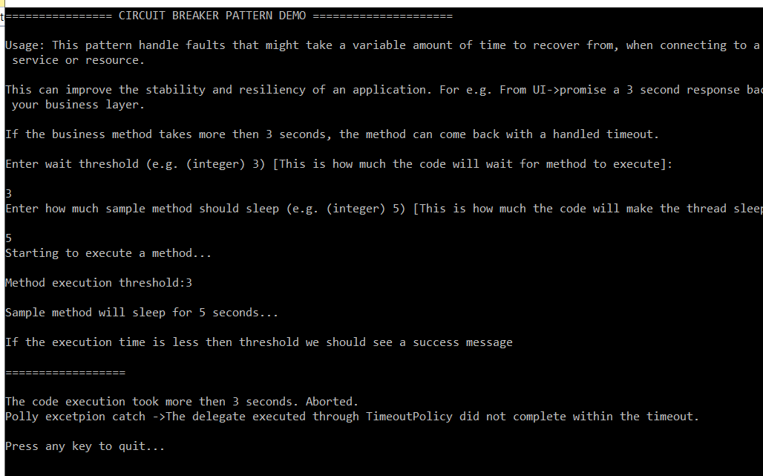
Demo solution (console and web app)
https://github.com/trivedimehulk/circuitbreakerdemo

Slide 6
references
https://docs.microsoft.com/en-us/azure/architecture/patterns/circuit-breaker
http://www.thepollyproject.org/

